Slide 1

📊 India Census 2011 - Population Demographics Dashboard
Presented by: Kunal Singh B.Tech CSE | LPU Date: April 2025

Slide 2

Introduction
Project focuses on analyzing India's population using 2011 census data
Visualized using Microsoft Excel's dashboarding capabilities
Objectives include state-wise and category-wise demographic comparisons

Slide 3
Project Objectives
Analyze
Analyze Population Density across states
Visualize
Visualize State-wise Male Population
Visualize
Visualize State-wise Female Population
Compare
Compare Rural vs Urban Households
Visualize
Visualize Population Density Heatmap

Slide 4
Dataset Source
Source: https://censusindia.gov.in/census.website/data/census-tablesDataset A-1_NO_OF_VILLAGES_TOWNS_HOUSEHOLDS_POPULATION_AND_AREA
01
Format: Excel (.xlsx), 10,000+ rows
02
Data fields: State name, gender-wise population, area, household counts
03

Slide 5
Data Cleaning and Preparation
1) Removed merged headers and blank rows 2) Converted columns to numeric data types 3) Filtered only state-level entries 4) Formatted the table as a dynamic Excel table

Slide 6
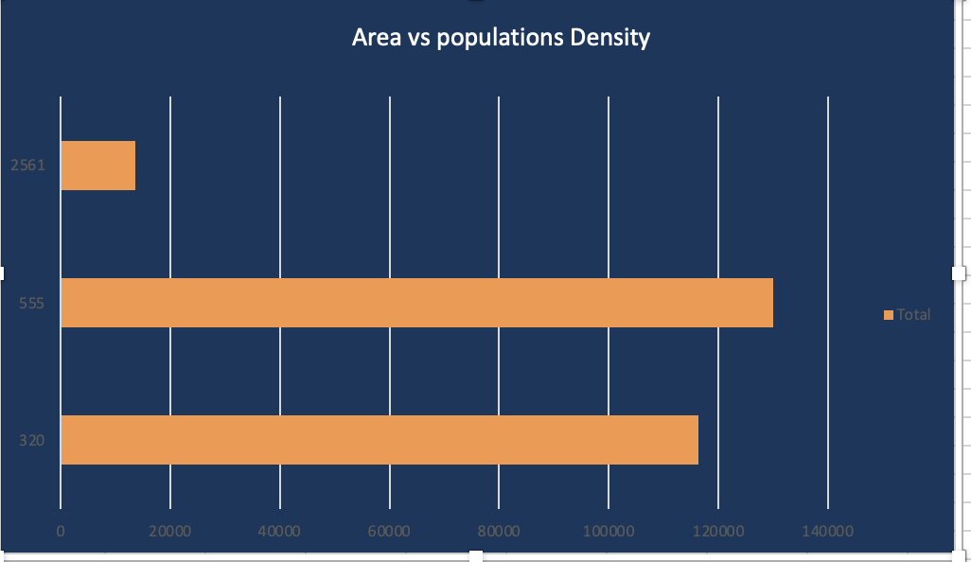
Population Density Analysis
Bar chart shows top 10 most densely populated states
Choropleth map for all India visualization
High density in Bihar, West Bengal, Kerala

Slide 7
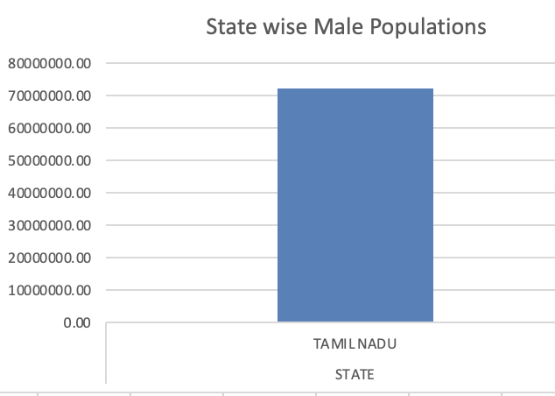
State-wise Male Population
Stacked Column: Male population in each state
Filterable using slicers by state or region
Useful for gender-based demographic studies

Slide 8
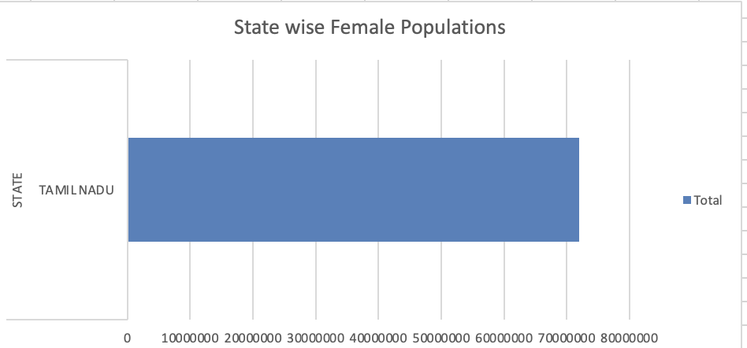
State-wise Female Population
Bar chart: Female population in each state
Compared side-by-side with male population
Analysis of gender imbalance in states

Slide 9
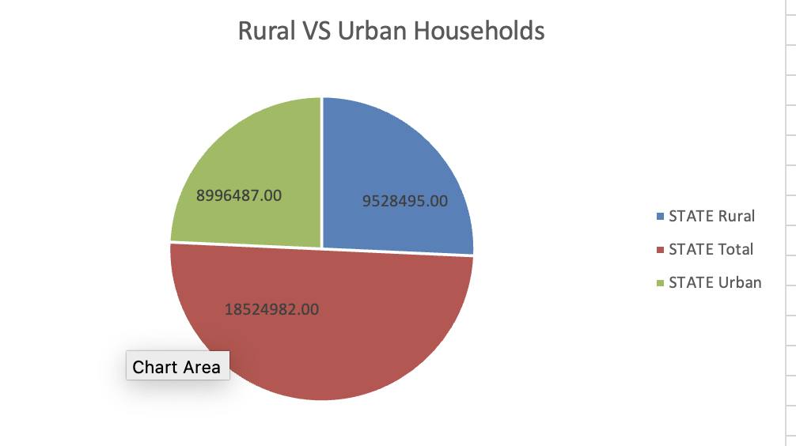
Rural vs Urban Households
Pie chart: Rural vs Urban household count per state
Pie chart: National level household distribution
Filters enabled for state-wise breakdown

Slide 10
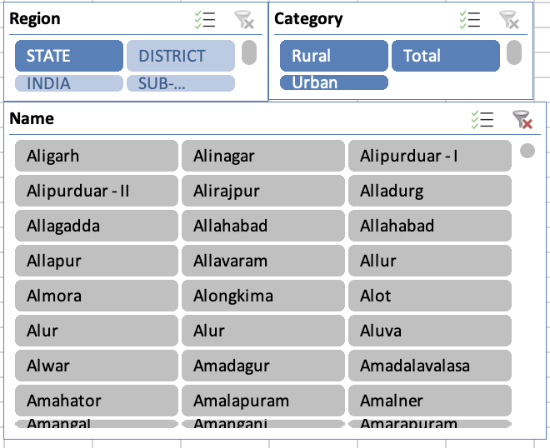
Slicer and Interactivity Demo
Added slicers: State, Region, Gender, Household Type
Makes dashboard dynamic and customizable
View specific state or category data instantly

Slide 11
Key Insights Extracted
Rural households dominate overall distribution
Top 3 most populous states: UP, Maharashtra, Bihar
Female-to-male ratio varies widely by region
Urban households higher in developed states

Slide 12
Challenges Faced
Formatting inconsistencies in raw dataset
Large file size caused processing delay
Creating region-based filters manually
Designing map-based visuals in Excel

Slide 13
Learning Outcomes
Enhanced Excel dashboarding skills
Better understanding of census datasets
Learned to tell data stories using charts and visuals
Practiced pivot tables, slicers, and data cleaning

Slide 14
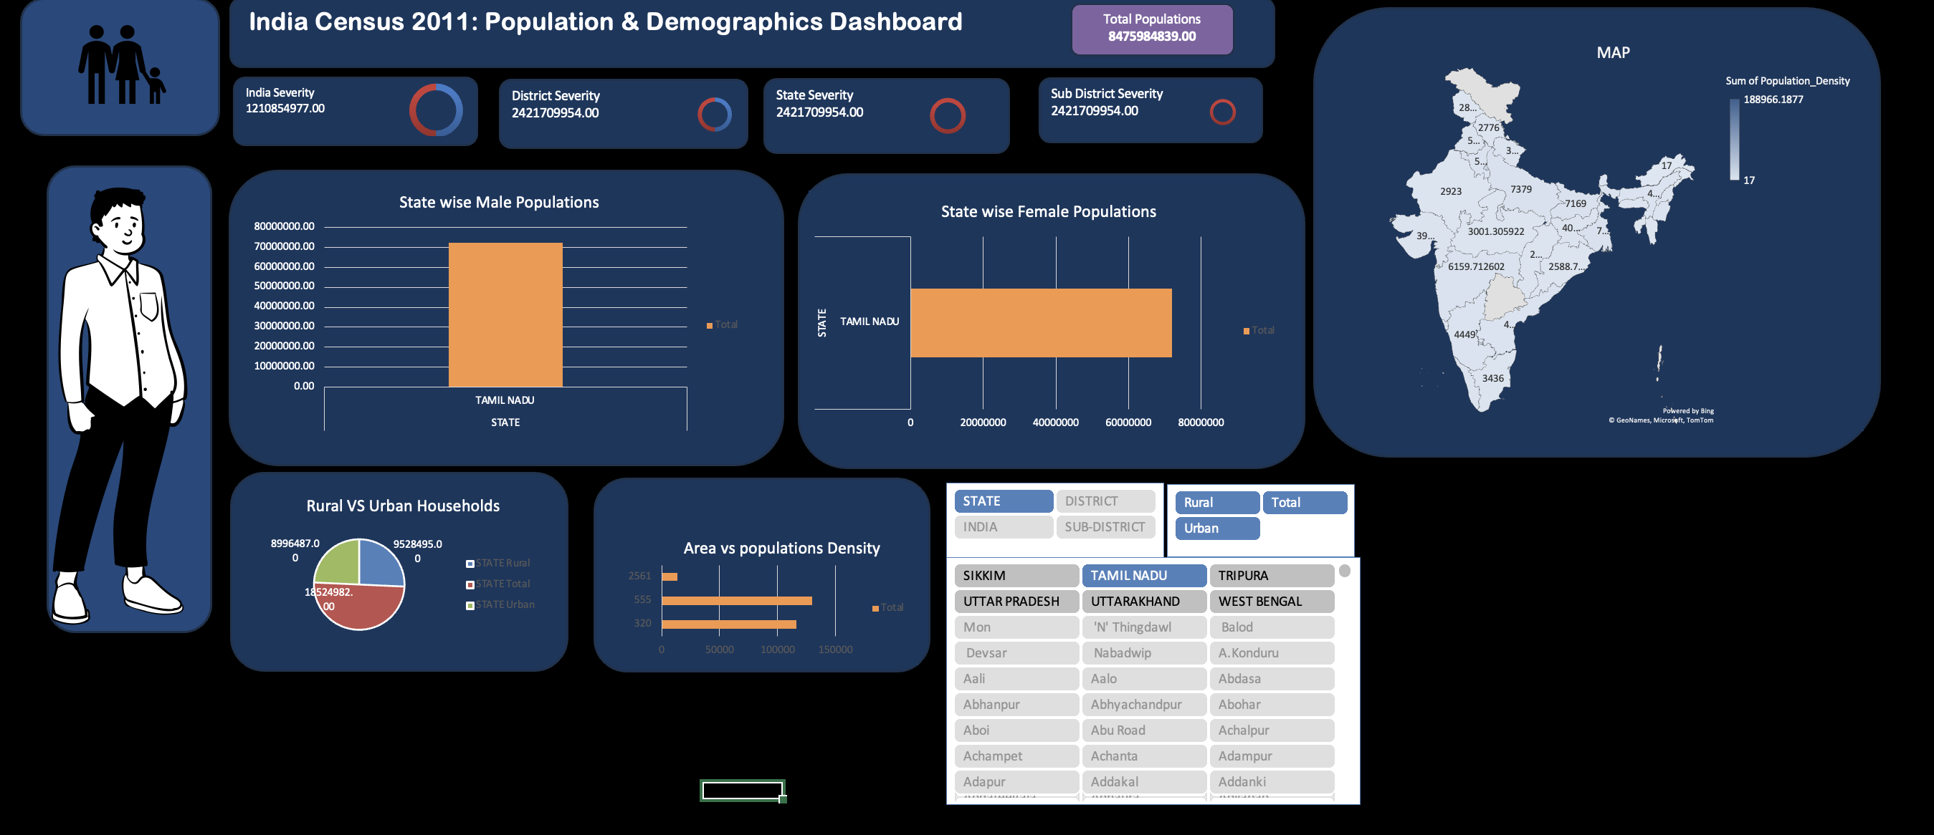
Final Project

Slide 15
Conclusion
Excel can be a powerful tool for demographic data analysis
Census dashboard helps make insights accessible to all
This project demonstrates real-world application of data visualization

Slide 16
Future Scope
Add literacy, age group, and economic datasets
Migrate dashboard to Power BI or Tableau for advanced visuals
Use real-time APIs and more recent census updates

Slide 17

Thank You Name: Kunal Singh
Project: India Census Population Dashboard
Course: INT217
Questions & Feedback Welcome!

